Slide 1
Final Project
Due May 10, 2019

Slide 2
Apparel Line
Design a line of school spirit wear for your home high school, BACC, or the college/trade school you plan to attend after high school.

Slide 3
Your line should have:
4 tops (t-shirt, sweatshirt, baseball tee, zip up, etc.)
4 bottoms (basketball shorts, running shorts, sweatpants, etc.)
3 accessories (hat, bag, sport accessories, etc.)
*At least 1 top should be non-sport specific, just the school in general.

Slide 4
Design your Apparel Pitch
Your display should include:
Your design on a solid background
Mock up of design on the item
Item name
Item Color
Item size range available
Vinyl colors
Manufacturing price
Sale price
Production notes

Slide 5
Top 1: Jersey
Augusta Sportswear – Women’s Short Sleeve Fanatic T-Shirt – 3011
Purple/White
XSmall - 3XLarge
Matte Golden Yellow & Glitter White
Manufacture Price: $16
Sale Price: $25
Fonts: Varsity Regular & Beyond the Rain

Slide 6
Top 1: Jersey

Slide 7
Bottom 1: Compression Shorts
Badger Girl’s Pro-Compression Shorts – 2629
Black
XSmall - XLarge
Matte Golden Yellow & Glitter White
Manufacture Price: $16
Sale Price: $25
Font: Beyond the Rain

Slide 8
Bottom 1: Compression Shorts

Slide 9
Top 2: Racerback Tank
Badger – B-Core Women’s Racerback Tank Top
Black
XSmall - 2XLarge
Matte Hot Pink & Matte White
Manufacture Price: $6
Sale Price: $12
Fonts: Varsity Regular

Slide 10
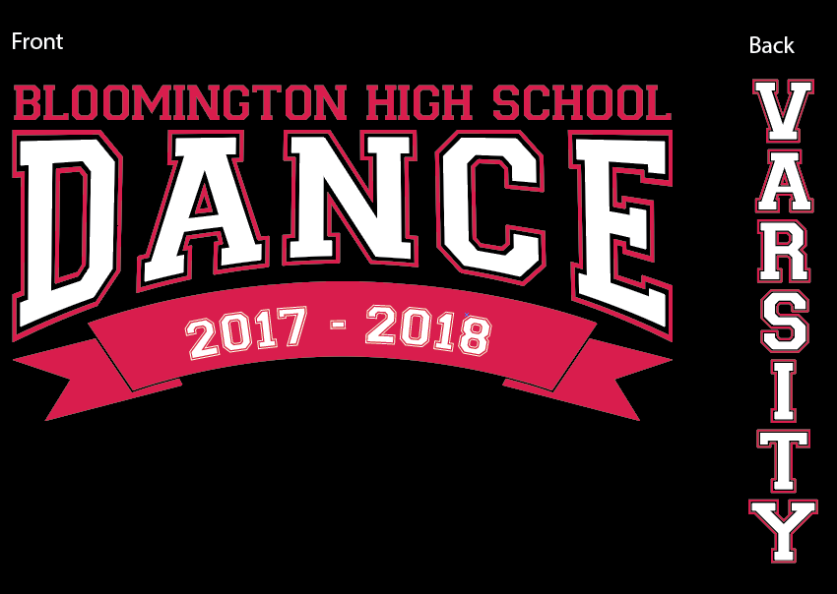
Top 2: Racerback Tank

Slide 11
Bottom 2: Athletic Shorts
Boxercraft – Women’s Velocity Running Shorts – P62
Pink/Black/White
XSmall - 2XLarge
Matte White
Manufacture Price: $9
Sale Price: $14
Font: Varsity Regular

Slide 12
Bottom 2: Athletic Shorts

Slide 13
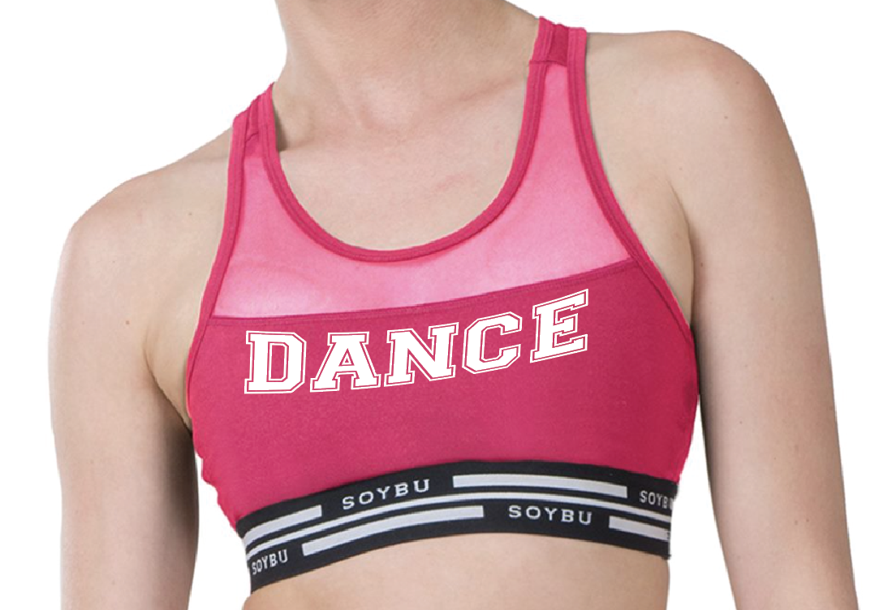
Accessory 1: Sports Bra
Soybu Women’s Athletic Bra
Pink
XSmall - XLarge
Matte White
Manufacture Price: $9
Sale Price: $12
Fonts: Varsity Regular

Slide 14
Accessory 1: Sports Bra

Slide 15
Top 3: Racerback Tank
Badger – B-Core Women’s Racerback Tank Top
White
XSmall - 2XLarge
Matte Purple & Matte Golden Yellow
Manufacture Price: $6
Sale Price: $12
Fonts: Varsity Regular & Before the Rain

Slide 16
Top 3: Racerback Tank

Slide 17
Bottom 3: Compression Shorts
GTM Women’s-Compression Crop Leggings – 2629
Purple
XSmall - XLarge
Matte White
Manufacture Price: $18
Sale Price: $30
Font: Varsity Regular

Slide 18
Bottom 3: Compression Shorts

Slide 19
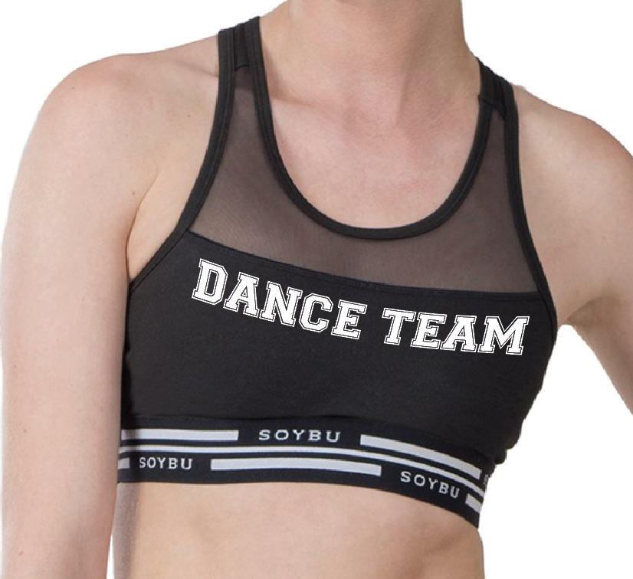
Accessory 2: Sports Bra
Soybu Women’s Athletic Bra
Black
XSmall - XLarge
Matte White
Manufacture Price: $9
Sale Price: $12
Fonts: Varsity Regular

Slide 20
Accessory 2: Sports Bra

Slide 21
Top 4: Racerback Tank
Velocity Women’s Twist Tank Top
White
XSmall - 2XLarge
Matte Lime & Matte Black
Manufacture Price: $12
Sale Price: $18
Fonts: Bebas Neau & Varsity Regular

Slide 22
Top 4: Racerback Tank

Slide 23
Bottom 4: Athletic Shorts
Boxercraft – Women’s Velocity Running Shorts
Lime/Black/White
P62 XSmall - 2XLarge
Matte White
Manufacture Price: $9
Sale Price: $14
Font: Varsity Regular

Slide 24
Bottom 4: Athletic Shorts

Slide 25
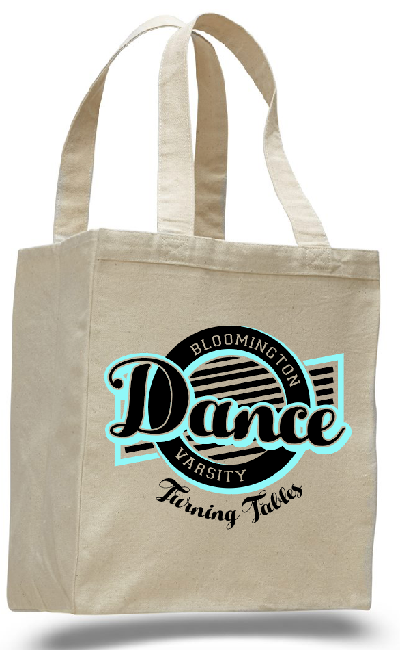
Accessory 3: Canvas Tote Bag
Q-Tees – 12L Canvas Gusset Shopping Tote – Q1000
Natural
One Size
Matte Black & Matte Seafoam
Manufacture Price: $2
Sale Price: $10
Fonts: Varsity Regular & Hello Script

Slide 26
Accessory 3: Canvas Tote Bag

Slide 27
Top 5: Racerback Tank
Badger – B-Core Women’s Racerback Tank Top
Purple
XSmall - 2XLarge
Matte White & Glitter Silver
Manufacture Price: $6
Sale Price: $12
Fonts: The Bold Font & Before the Rain

Slide 28
Top 5: Racerback Tank

Slide 29
Bottom 5: Compression Crop Pants
GTM Women’s-Compression Crop Leggings - 2629
Black
XSmall - XLarge
Glitter Silver
Manufacture Price: $18
Sale Price: $30
Font: Before the Rain

Slide 30
Bottom 5: Compression Crop Pants

Slide 31
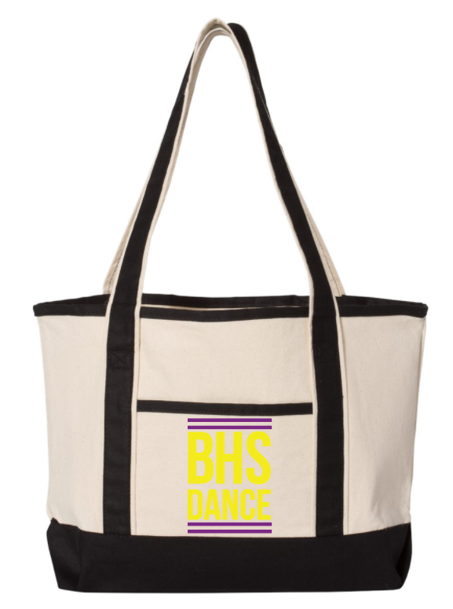
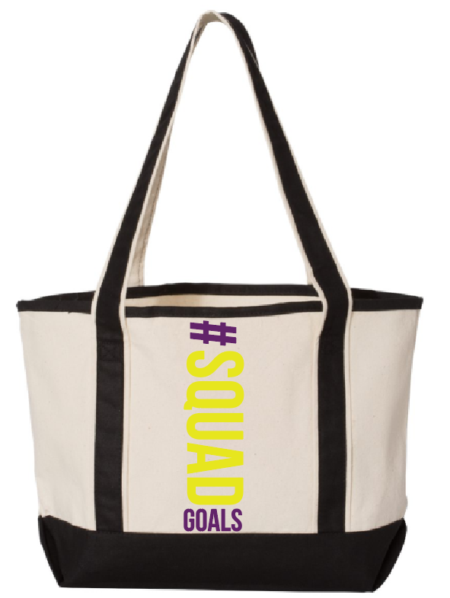
Accessory 4: Canvas Tote Bag
Q-Tees – 20L Canvas Gusset Delux Tote – Q125800
Natural/Black
One Size
Matte Purple & Matte Golden Yellow
Manufacture Price: $4
Sale Price: $15
Fonts: Bebas Neau

Slide 32
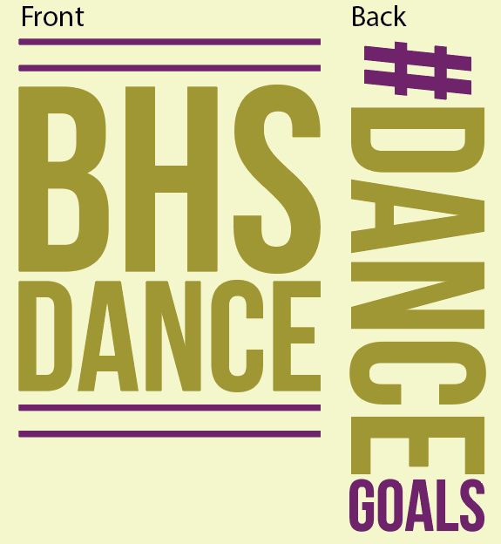
Accessory 4: Canvas Tote Bag

